Slide 1
Dimensionality Reduction and Feature Construction
Principal components analysis (PCA)
  Reading: L. I. Smith, A tutorial on principal components analysis (on class website)
  PCA used to reduce dimensions of data without much loss of information.
  Used in machine learning and in signal processing and image compression (among other things).

Slide 2
PCA is “an orthogonal linear transformation that transfers the data to a new coordinate system such that the greatest variance by any projection of the data comes to lie on the first coordinate (first principal component), the second greatest variance lies on the second coordinate (second principal component), and so on.”

Slide 3
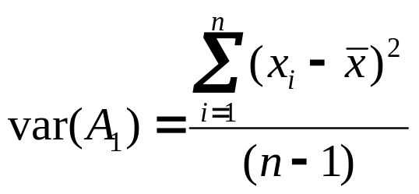
Background for PCA
Suppose attributes are A₁ and A₂, and we have n training examples. x’s denote values of A₁ and y’s denote values of A₂ over the training examples.
Variance of an attribute:

Slide 4
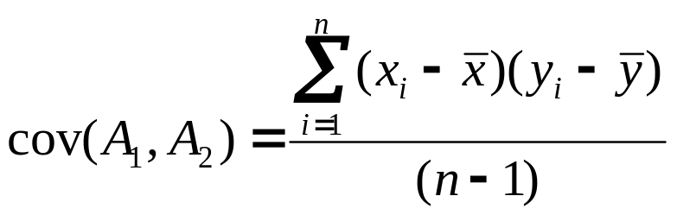
Covariance of two attributes:
If covariance is positive, both dimensions increase together. If negative, as one increases, the other decreases. Zero: independent of each other.

Slide 5
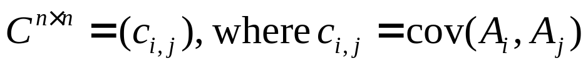
Covariance matrix
  Suppose we have n attributes, A₁, ..., A_{n}.
  Covariance matrix:

Slide 6
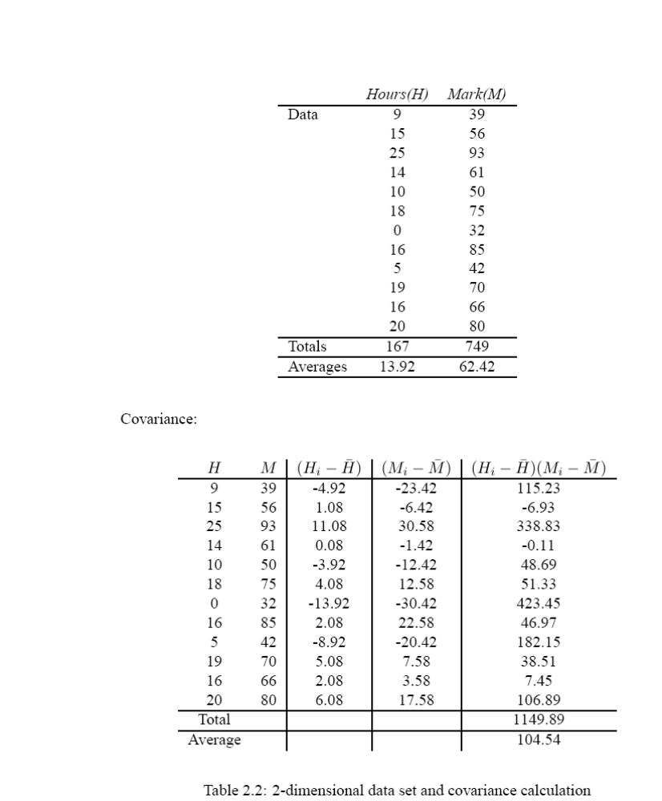
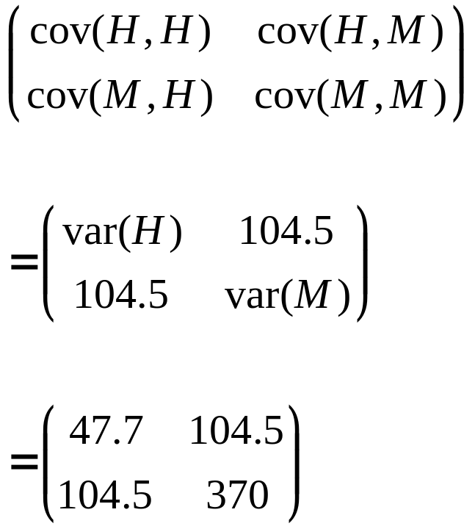
Covariance matrix

Slide 7

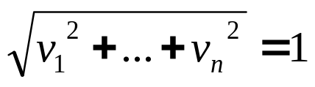
Eigenvectors:
  Let M be an n×n matrix.
    v is an eigenvector of M if M × v = λv
    λ is called the eigenvalue associated with v
  For any eigenvector v of M and scalar a,
  Thus you can always choose eigenvectors of length 1:
  If M has any eigenvectors, it has n of them, and they are orthogonal to one another.
  Thus eigenvectors can be used as a new basis for a n-dimensional vector space.

Slide 8
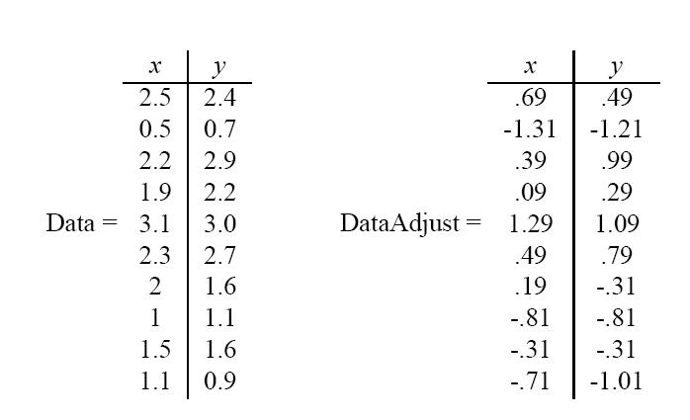
PCA
Given original data set S = {x¹, ..., x^{k}}, produce new set by subtracting the mean of attribute A_{i} from each x_{i}.
Mean: 1.81 1.91
Mean: 0 0

Slide 9
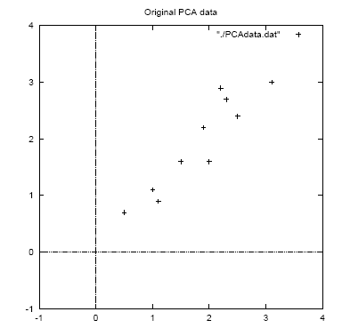

Slide 10
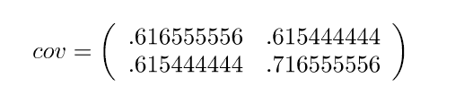
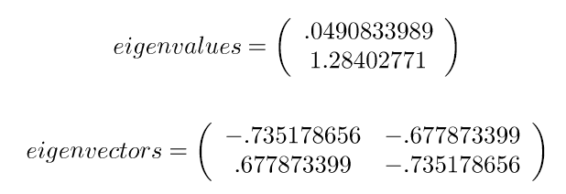
Calculate the covariance matrix:
Calculate the (unit) eigenvectors and eigenvalues of the covariance matrix:
x y
x
y

Slide 11
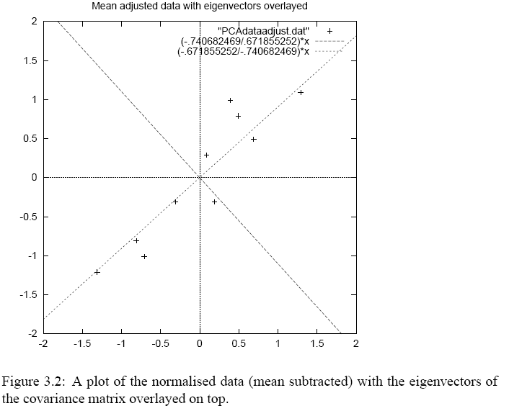
Eigenvector with largest
eigenvalue traces
linear pattern in data

Slide 12
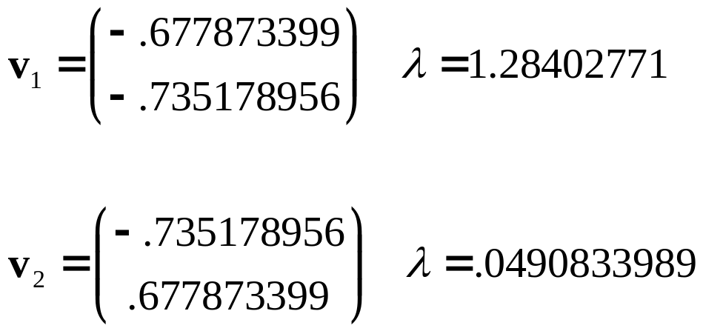
Order eigenvectors by eigenvalue, highest to lowest.
In general, you get n components. To reduce dimensionality to p, ignore n−p components at the bottom of the list.

Slide 13
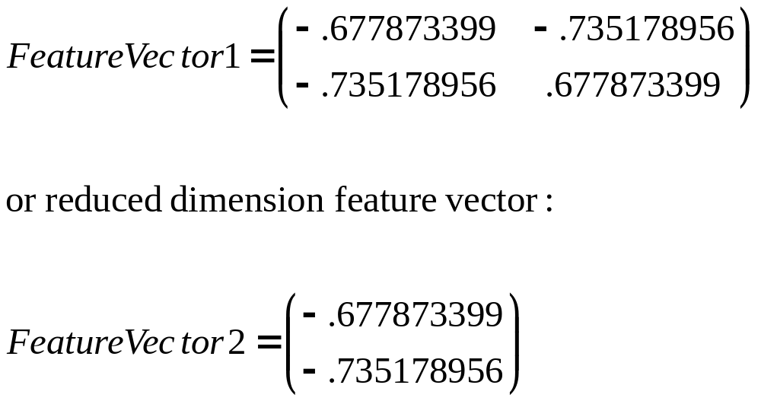
Construct new feature vector.
  Feature vector = (v₁, v₂, ...v_{p})

Slide 14
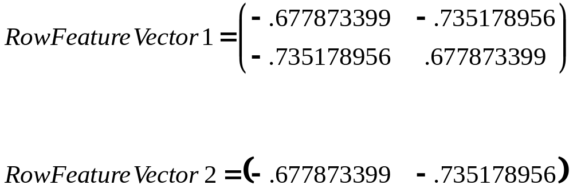
Derive the new data set.
  TransformedData = RowFeatureVector × RowDataAdjust
  This gives original data in terms of chosen components (eigenvectors)—that is, along these axes.

Slide 15
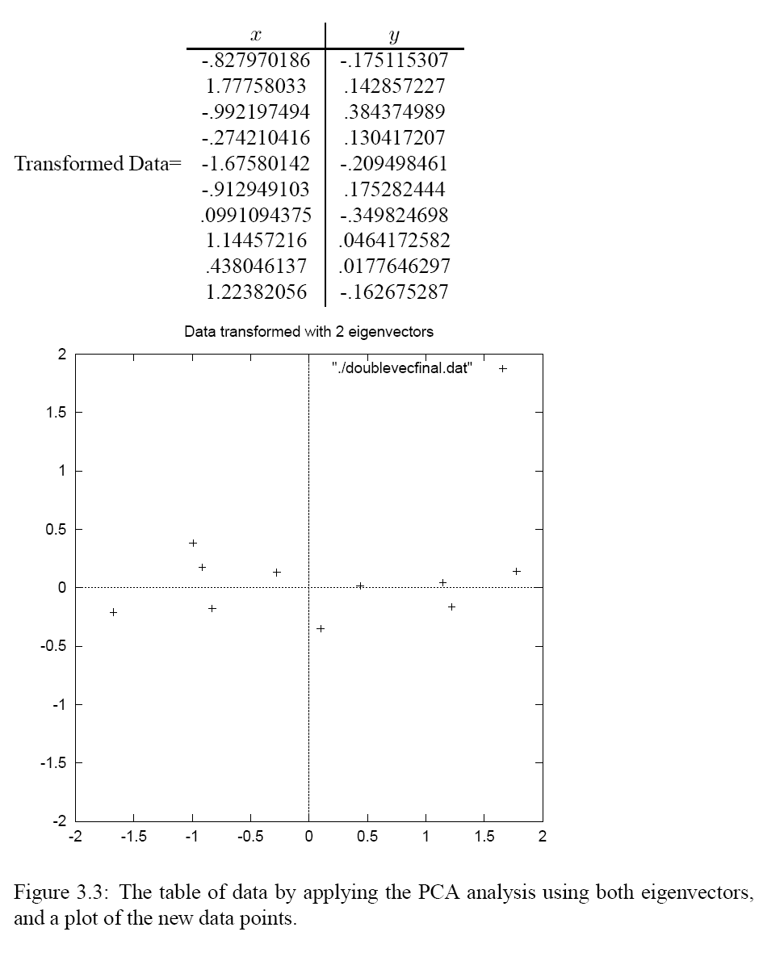

Slide 16
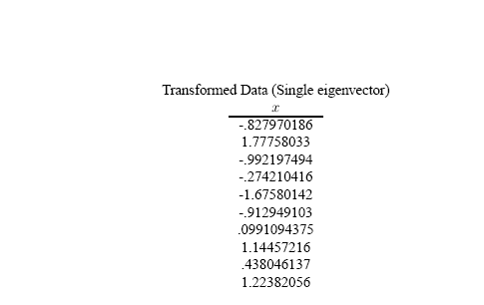
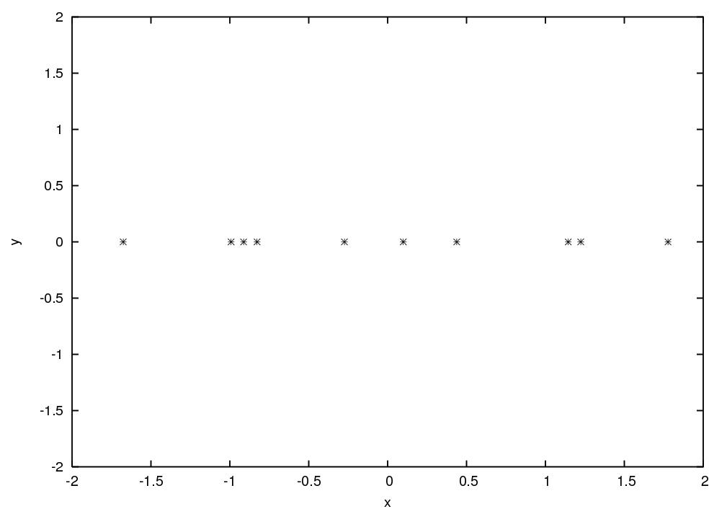

Slide 17
Reconstructing the original data
  We did:
  TransformedData = RowFeatureVector × RowDataAdjust
  so we can do
  RowDataAdjust = RowFeatureVector ⁻¹ × TransformedData
  = RowFeatureVector ^{T} × TransformedData
  and
  RowDataOriginal = RowDataAdjust + OriginalMean

Slide 18
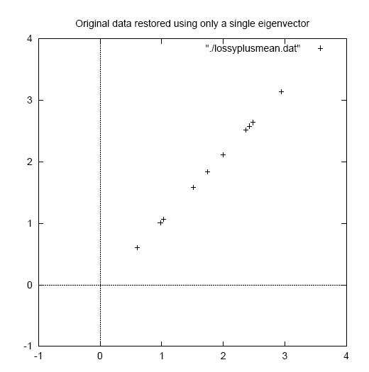

Slide 19
Example: Linear discrimination using PCA for face recognition
Preprocessing: “Normalize” faces
  Make images the same size
  Line up with respect to eyes
  Normalize intensities

Slide 20
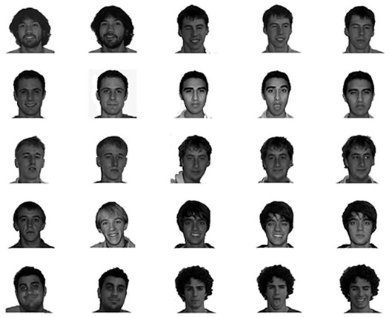

Slide 21
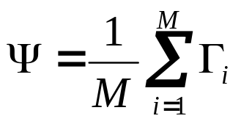
Raw features are pixel intensity values (2061 features)
Each image is encoded as a vector Γ_{i} of these features
Compute “mean” face in training set:

Slide 22
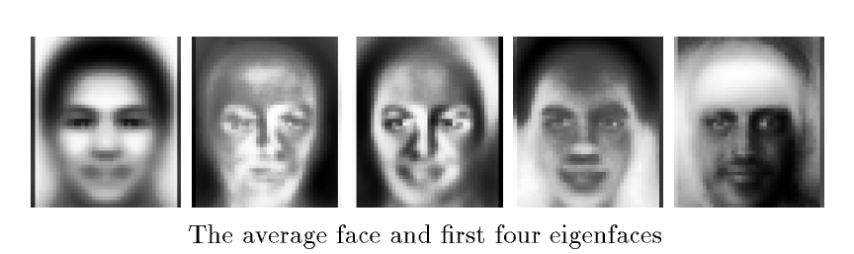

Subtract the mean face from each face vector
Compute the covariance matrix C
Compute the (unit) eigenvectors v_{i} of C
Keep only the first K principal components (eigenvectors)

Slide 23
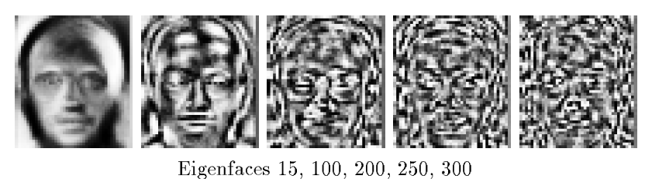
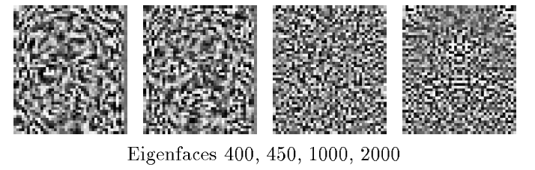

Slide 24
The eigenfaces encode the principal sources of variation
in the dataset (e.g., absence/presence of facial hair, skin tone,
glasses, etc.).
We can represent any face as a linear combination of these
“basis” faces.
Use this representation for:
  Face recognition
  (e.g., Euclidean distance from known faces)
  Linear discrimination
(e.g., “glasses” versus “no glasses”,
or “male” versus “female”)

